Slide 1
Endocrine System
Anatomy 7.1

Slide 2
Description
Slow-acting communication system

Slide 3
Consists of:
Glands: An organ that secretes a hormone. Hormone: Chemical messenger | Target Organ (cells): An organ/cell that responds to a specific hormone.

Slide 4
Classification of Hormones:
Proteins: Large/hydrophilic Bind to target cells Alters cell behavior | Steroids: Hydrophobic Diffuse freely into all cells.

Slide 5
Control Feedback:
Positive: Hormone causes target cell to increase product (rare) Contractions, blood clotting, & lactation | Negative: Keeps body in homeostasis Blood calcium levels

Slide 6
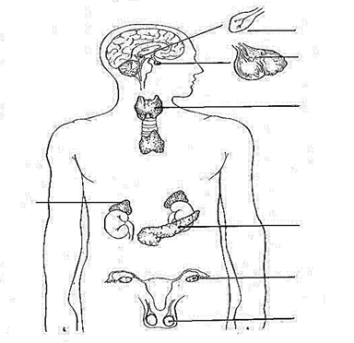
Endocrine Glands:
Pineal
Pituitary
Thyroid
Adrenal
Pancreas
Ovaries
Testes

Slide 7
Gland Hormone Chart:
Gland | Hormone | Action
Pineal | Melatonin | Involved in rhythmic daily & seasonal activities
Pituitary | Oxytocin | Contracts uterus & milk letdown reflex
Pituitary | Growth Hormone | Bone & muscle growth
Pituitary | Prolactin | Stimulates milk production
Pituitary | Follicle Stimulating Hormone (FSH) | Production of egg & sperm
Pituitary | Luteinizing Hormone | W: Regulates menstrual cycle M: Regulates testosterone

Slide 8
Gland Hormone Chart:
Gland | Hormone | Action
Thyroid | Thyroxine | Stimulates metabolism
Thyroid | Calcitonin | Metabolizes calcium & phosphorus
Adrenal | Epinephrine/Norepinephrine | Gives superhuman strength in stressful situations
Pancreas | Insulin | Lowers blood glucose levels
Pancreas | Glucagon | Increases blood glucose levels
Testes | Androgens (Testosterone) | Sperm formation & secondary sex characteristics
Ovaries | Estrogens | Lining of the uterus & secondary sex characteristics

Slide 9
Disorders:
Diabetes: Pancreas does not produce enough insulin Blood sugar levels +++ | Anabolic Steroid Abuse + = Can rebuild damaged tissues - = Agressive behavior, acne, liver disease, & cancer

