Slide 1
Immune System
Anatomy 8.1

Slide 2
Immunity: Resistance to a specific disease | Pathogens: “Germ”;harmful disease-causing microorganism

Slide 3
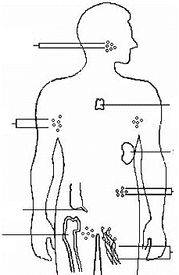
Organs of the Immune System
Tonsils & Adenoids
Thymus
Lymph Nodes
Spleen
Peyer’s Patches
Appendix
Bone Marrow
Lymph Nodes & Vessels

Slide 4
Organs of the Immune System
Tonsils: Trap germs that enter through the mouth or nose (Back of throat)
Adenoids: Trap germs that enter through the mouth or nose (Behind soft palate)
Lymph Nodes: Small structures that filter germs from lymph fluid (neck, armpit, groin)
Lymph Vessels: Carry lymph fluid through the body.
Appendix: Repopulates Lrg. intestine w/good bacteria after an infection/illness.

Slide 5
Organs of the Immune System
Bone Marrow: Where blood cells are produced (including leukocytes)
Thymus: Functions until puberty to produce T-Cells
Spleen: Filters blood of old RBC’s & stores platelets & WBC’s.
Peyer’s Patches: Found in small intestines. Monitors bacterial growth & prevents bad bacteria.

Slide 6
2 Divisions of the Immune Systems
Non Specific: 1st line of defense Protects body from all foreign matter Ex: Skin, mucous membranes, inflammatory response | Specific: 2nd line of defense Attacks particular foreign substance. Ex: Immune system cells (See below)

Slide 7
Specific Immune System Cells
B Lymphocytes (B-Cells): “Bone Marrow” Cells; Produce plasma cells & memory cells
Plasma Cells: Produce antibodies
Memory Cells: Made during initial infection & remains in body after disease is gone.
Macrophage: Engulf & digest foreign matter

Slide 8
Specific Immune System Cells
T Lymphocytes (T-Cells): “Thymus” Cells; Fighter cells
Helper T-Cells: Help fight invader
Killer T- Cells: Kills virus invaded body cells
Supressor T-Cells: Stops B&T cells once the infection has been killed

