Slide 1
The Human Skeleton
Anatomy 4.2

Slide 2
Number of Bones in the
Human Body
206
(270 at birth)

Slide 3
Divisions of the Skeleton
Axial Forms longitudinal axis of the body | Appendicular Forms limbs & girdles

Slide 4
Types of Bone
Compact Dense & looks smooth | Spongy Porous, needle-like pieces

Slide 5
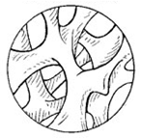
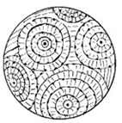
Spongy Bone
“Cancellous Bone”
Compact Bone
“Cortical Bone”

Slide 6
Please get out 4 colors.
We will color code the diagrams as a class

