Slide 1
Male Reproductive System
Anatomy 10.2

Slide 2
Functions
Produce, maintain, & support sperm/semen
Discharge sperm into the female reproductive tract
Produce & secrete male hormones that maintain the male reproductive system

Slide 3
Hormones
Follicle Stimulating Hormone: Promotes sperm production
Luteinizing Hormone: Stimulates production of testosterone
Testosterone: Responsible for male secondary sex characteristics
Muscle mass/strength
Facial hair
Voice change
Sex drive

Slide 4
Penis
Male organ used in sexual intercourse
Root: Attaches to wall of abdomen
Shaft: Length of penis
Glans: Dome-shaped head of penis; covered with foreskin
Chambers: 3 cylindrical chambers
Corpus Cavernosum: 2 along the sides; fills with blood = erection
Corpus Spongiosum: 1 along the front; fills with blood = keeps urethra open for sperm

Slide 5
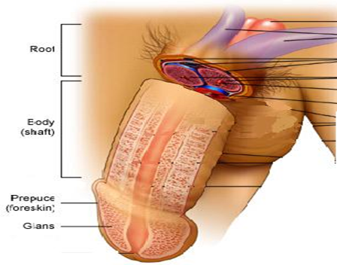
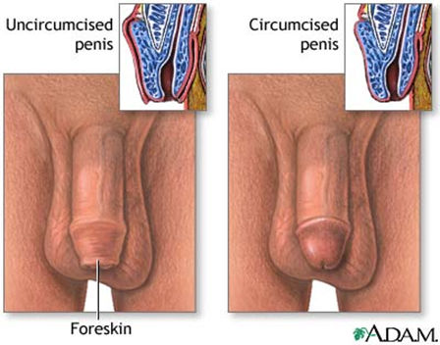
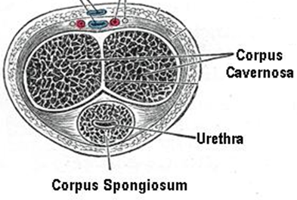

Slide 6
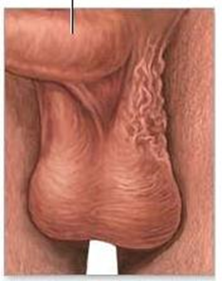
Scrotum
Loose pouch-like sac of skin that houses the testicles
Keeps testicles cool: 96 degrees F
Cremaster muscle: Contracts & relaxes to adjust temperature.

Slide 7
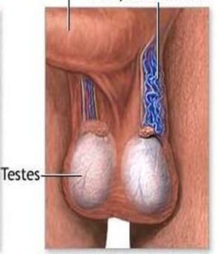
Testicles (Testes)
Oval organs responsible for producing testosterone.
House the seminiferous tubules (produce sperm)

Slide 8
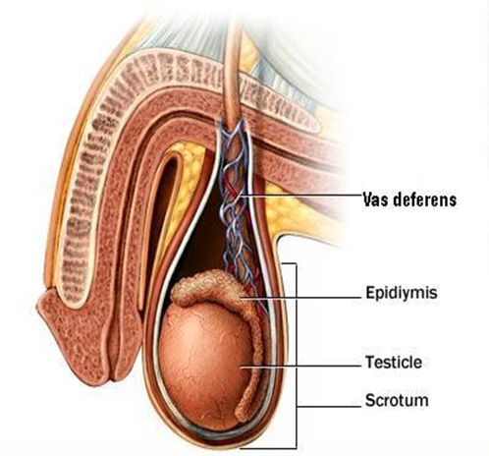
Epididymis
Coiled tubes on the backside of each testicle
Transport & store sperm until mature
Leads sperm into the vas deferens

Slide 9
Vas Deferens
Tube that transports mature sperm from the epididymis to the urethra in preparation for ejaculation.

Slide 10
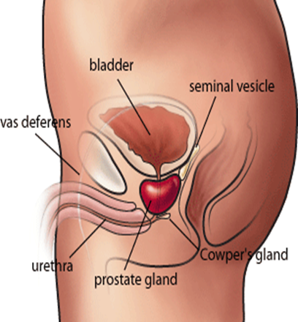
Seminal Vesicles
Sac-like pouches that attach to the vas deferens to produce sugar-rich fluid that nourish sperm.
Makes up most of the ejaculate

Slide 11
Prostate Gland
Walnut sized gland below bladder that adds additional fluid to ejaculate
Semen: Milky white liquid that serves as a medium to transport sperm (swim)

