Slide 1
Spinal Cord Anatomy & Nervous System Disorders
Anatomy 6.3

Slide 2
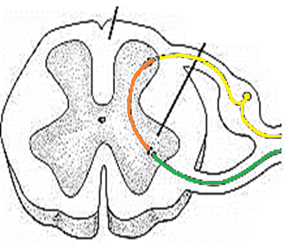
Spinal Cord Anatomy
Back
Gray Matter
Central “butterfly”
Larger front wings = Motor Neurons
Smaller back wings = Sensory Neurons
Front

Slide 3
Spinal Cord Anatomy
Back
White Matter
Columns of nerve fibers surrounding gray matter
Ascending Tract
Sensory info TO the brain
Descending Tract
Impulses from brain to muscle
Front

Slide 4
Nervous System Disorders
Alzheimer’s Disease Progressive degeneration of the brain; memory, thinking, & behavior impaired | Cerebrovascular Accident “Stroke”; Death of brain cells due to lack of blood flow (obstruction)
Cerebral Edema Excess accumulation of water/pressure surrounding the brain. | Coma A state of complete unresponsiveness

Slide 5
Nervous System Disorders
Concussion Destruction of brain tissue due to trauma | Contusion Bruising of the brain
Intracranial Hemorrhage Rupture of blood vessels causing blood to pool around brain | Multiple Sclerosis Degeneration of the myelin sheath causing nerve impulses to slow/stop
Transient Ischemic Attack Warning/Mini stroke

