Slide 1
Fractures
Anatomy 4.6

Slide 2
Fracture | Specialized Cells
A break in a bone | Osteoblasts: Bone Builders Osteoclasts: Bone Destroyers

Slide 3
Types of Fractures
Simple Fracture
A clean break through a bone.

Slide 4
Types of Fractures
Compound Fracture
A bone protrudes through the skin.

Slide 5
Types of Fractures
Comminuted Fracture
Bone shatters into fragments

Slide 6
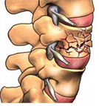
Types of Fractures
Compression Fracture
Typically in spine; bone collapses

Slide 7
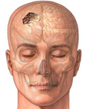
Types of Fractures
Depressed Fracture
Typically in skull; the bone becomes indented

Slide 8
Types of Fractures
Spiral Fracture
The two ends of a bone are forced in opposite directions.

Slide 9
Types of Fractures
Impacted Fracture
Ends of bone are pushed into each other

Slide 10
Types of Fractures
Greenstick Fracture
Incomplete break; typically in young children (flexible bones)

Slide 11
Method of Repair (Reduction: Realign)
Closed Reduction: Bones are realigned by a doctor without performing surgery | Open Reduction: Surgery is performed and bones are held in place by pins/wires.

Slide 12
Fracture Practice

Slide 13
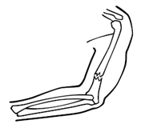
Bone is fractured.
1.

Slide 14
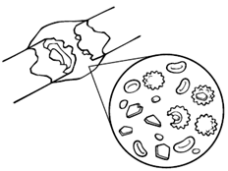
Blood clot forms; phagocytes clean bone fragments & germs.
2.

Slide 15
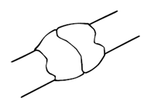
Soft callus forms; chondroblasts produce callogen
3.

Slide 16
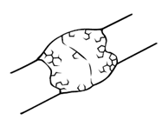
Hard callus forms; osteoblasts create new bone.
4.

Slide 17
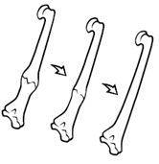
Remodeling; osteoclasts remove extra bone until completely healed.
5.

