Slide 1
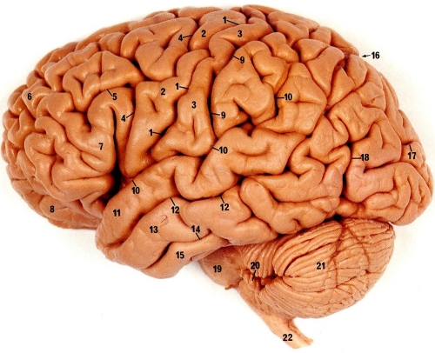
Anatomy of the Brain & Spinal Cord
Mrs. Halkuff
Anatomy & Physiology

Slide 2
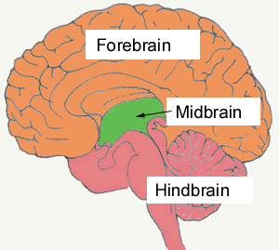
3 Major Divisions of the Brain:
Forebrain
Midbrain
Hindbrain

Slide 3
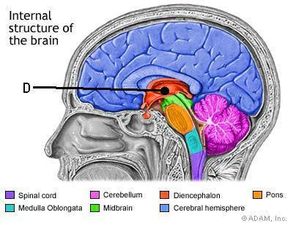
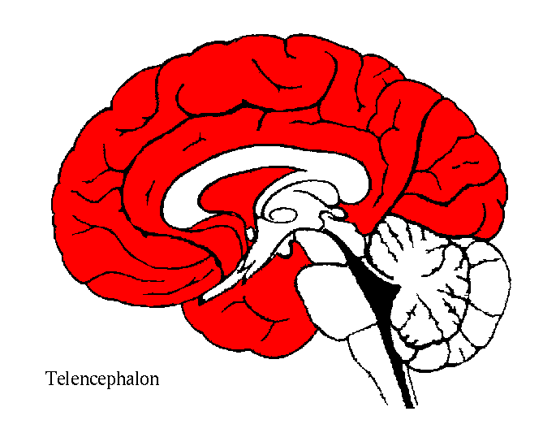
Forebrain
Diencephalon
Thalamus & Hypothalamus
Motor control & sensory info.
Controls autonomic functions
Telencephalon
A.K.A “Cerebral Cortex”
Largest part of the brain
Location of most information processing

Slide 4
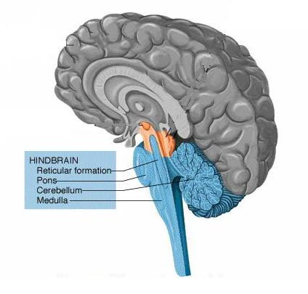
Hindbrain
Extends from the spinal cord.
Metencephalon
Pons
Cerebellum
Maintains balance & equilibrium
Coordination
Myelencephalon
Medulla Oblongata
Breathing
Heart rate & Digestion

Slide 5
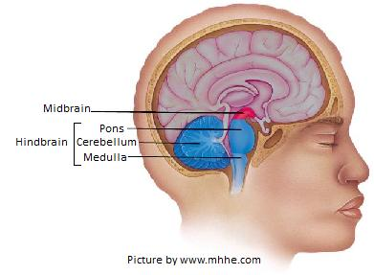
Midbrain
Brainstem that connects the forebrain to the hindbrain.
Auditory & Visual response
Motor Function

Slide 6
Major Structures
Hypothalamus: Regulates body temperature, hunger, homeostasis.
Thalamus: Relays sensory signals to & from the spinal cord and cerebrum.
Pons: Relay between cerebrum & cerebellum
Medulla Oblongata: Controls autonomic functions
Cerebellum: Movement & Coordination

Slide 7
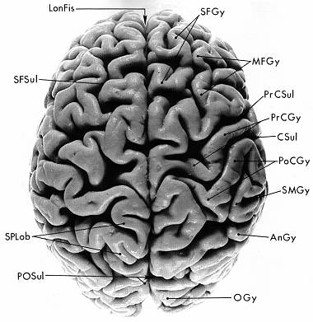
Cerebrum
Largest & Superior part of the brain.
Divided into 4 lobes.
Has gyri & sulci.
AnGy | Angular Gyrus
CSul | Central Sulcus (of Rolando)
LonFis | Longitudinal Fissure
MFGy | Middle Frontal Gyrus
OGy | Occipital Gyri
PoCGy | Postcentral Gyrus
POSul | Parieto-occipital Sulcus
PrCGy | Precentral Cyrus
PrCSul | Precentral Sulcus
SFGy | Superior Frontal Gyrus
SFSul | Superior Frontal Sulcus
SMGy | Supramarginal Gyrus
SPLob | Superior Parietal Lobule

Slide 8
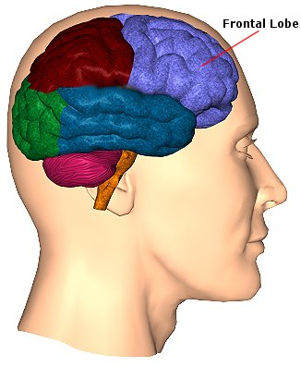
Cerebrum: Frontal Lobe
Reasoning
Motor Skills
Cognition
Emotions/Personality

Slide 9
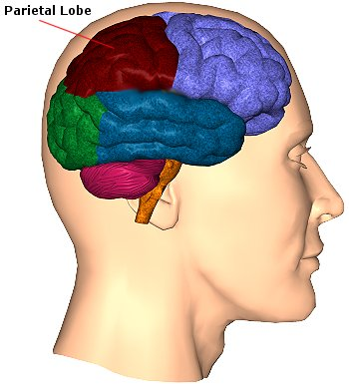
Cerebrum: Parietal Lobes
Receives & processes sensory information. (Pain, cold, touch, etc.)
Spatial relationships.

Slide 10
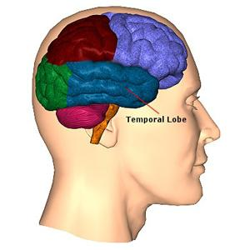
Cerebrum: Temporal Lobes
Hearing
Memories

Slide 11
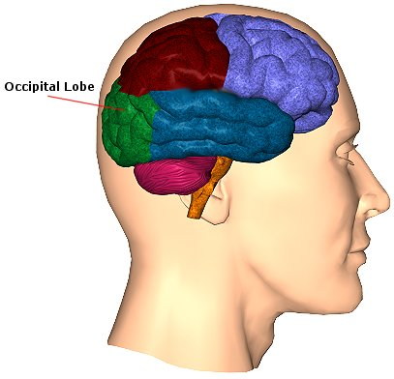
Cerebrum: Occipital Lobe
Sight

Slide 12
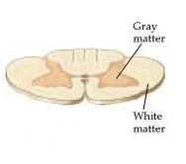
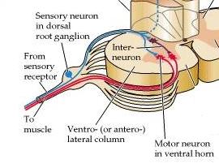
Anatomy of the Spinal Cord
Gray Matter: Butterfly shaped in center of cord.
Large front wings contain motor neurons.
Small back wings contain sensory neurons.
White Matter: Columns of nerve fibers that surround the Gray Matter.
Ascending Tract: Carry sensory information TO the brain.
Descending Tract: Carry impulses FROM the brain to the muscles.

Slide 13
Diseases & Disorders
Alzheimer’s disease: Progressive degeneration of the brain causing problems with memory, thinking, & behavior.
Cerebral edema: Excess accumulation of water surrounding the brain.
Cerebrovascular accident: A.K.A. Stroke. Death of brain cells due to a lack of blood flow caused by an obstruction.
Coma: A state of complete unresponsiveness.
Concussion: Destruction of brain tissue due to trauma.
Contusion: Bruising of the brain.
Intracranial hemorrhage: Rupture of a blood vessel causing blood to pool around the brain.
Multiple Sclerosis: Degeneration of the myelin sheath causing nerve impulses to slow/stop.
Transient ischemic attack: Warning/Mini stroke.

