Slide 1
Muscle Types & Movements
Anatomy & Physiology
Mrs. Halkuff

Slide 2
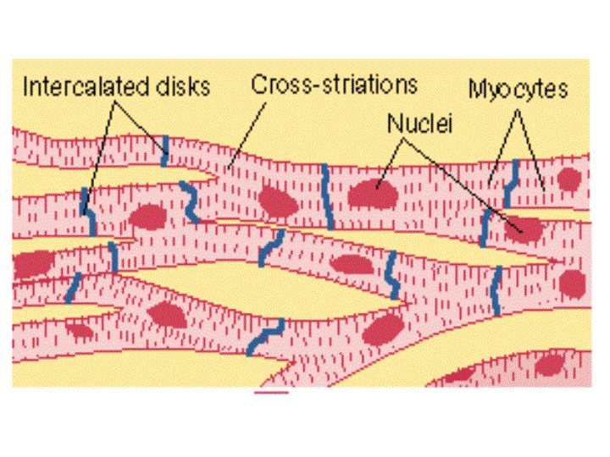
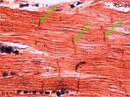
3 Types of Muscle
Cardiac Muscle
Involuntary
Striated
Intercalated Discs
Contract in rhythmic
fashion

Slide 3
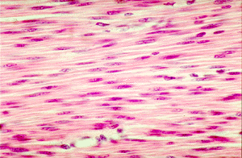
3 Types of Muscle
Smooth Muscle
Involuntary
Nonstriated
Lines hollow organs:
arteries, digestive tract,
bladder, uterus, & lungs

Slide 4
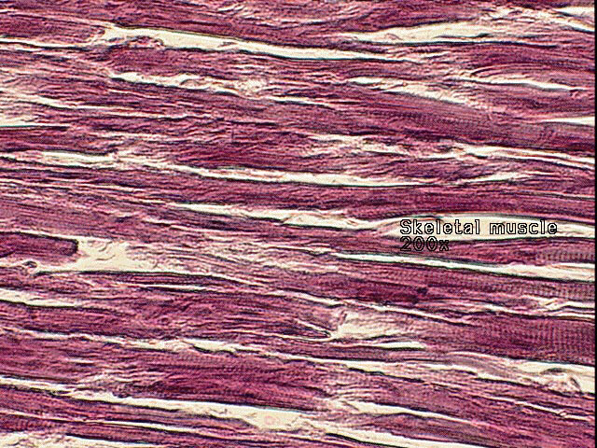
3 Types of Muscle
Skeletal Muscle
Voluntary
Striated
Connect to the bones
to produce movement.
640 muscles in the body.

Slide 5
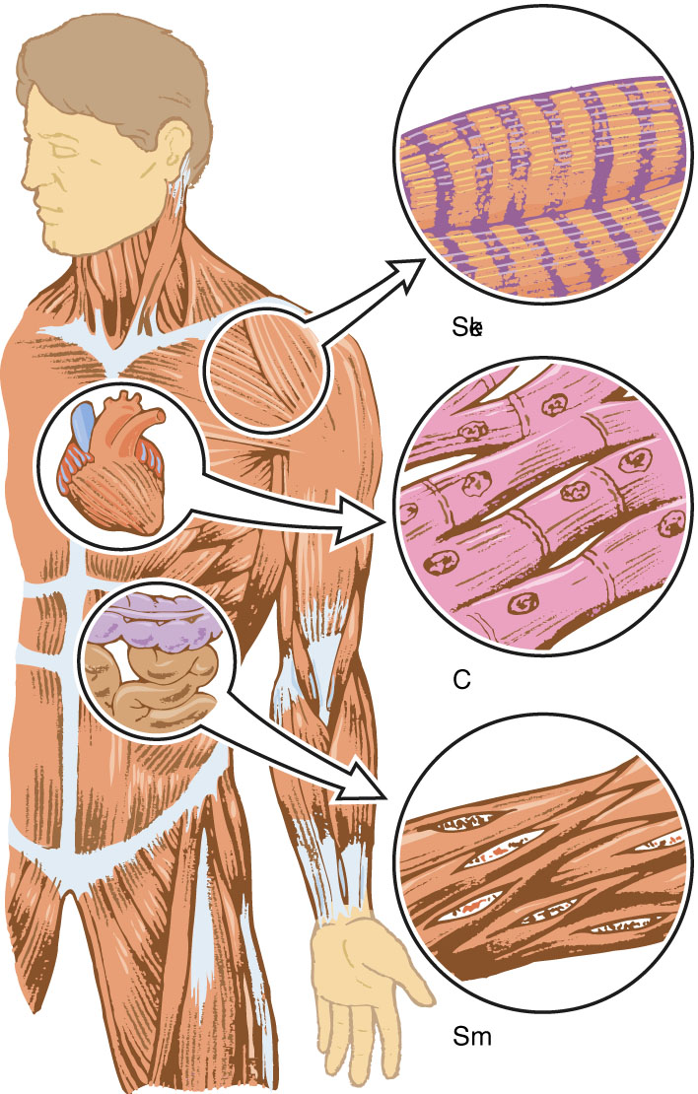

Slide 6
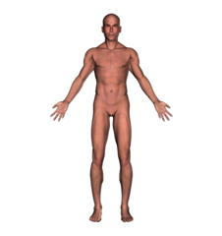
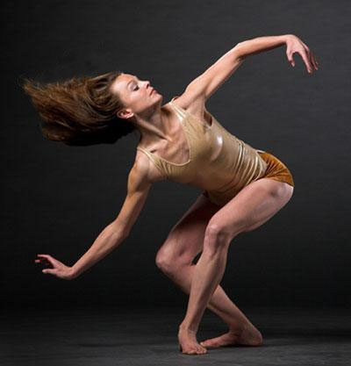
Movement is produced by the contraction of muscles.
All descriptions of position and movement assume anatomical position.

Slide 7
Origin, Insertion, & Action
Muscles have an Origin, Insertion, & Action.
Origin: Muscle attachment to an immovable bone.
Insertion: Muscle attachment to a moveable bone.
Movement is a muscle’s insertion moving toward or way from its origin.
Action: The movement that is produced from the muscle.

Slide 8
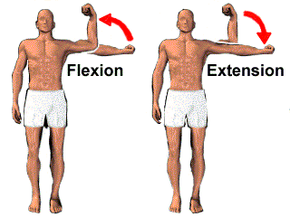
ADJUSTING AN ANGLE BETWEEN TWO BODY PARTS
Flexion: Reduces the angle between two articulating elements.
Extension: Increases the angle between two articulating elements.

Slide 9
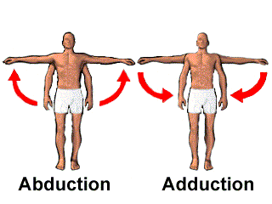
ADJUSTING THE BODY IN RELATION TO THE MIDLINE OF THE BODY
Abduction: Movement away from the center/midline.
Adduction: Movement toward the midline of the body.
Refers to the appendicular skeleton only.

Slide 10
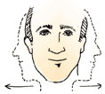
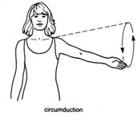
MOTIONS IN AN ARC
Rotation: Turning the body on an axis, such as shaking your head ‘no’.
Circumduction: Circular movements.

Slide 11
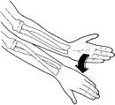
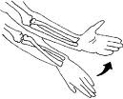
ROTATION OF THE FOREARM
Pronation: Palm up to palm down.
Supination: Palm down to palm up

Slide 12
MEDIAL & LATERAL FLEXION OF FOOT
Inversion: Movement of the foot inward, toward the median plane.
Eversion: Movement of the foot outward, away from the median plane.

Slide 13
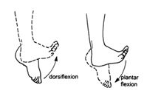
FLEXION OF ENTIRE FOOT
Dorsiflexion: Elevating the sole and digging the heel.
Plantar Flexion: Extending the ankle and elevating the heel. Pointing the toes.

